Slide 1
DESIGN AND FABRICATION OF CONTROL MOMENT GYROSCOPE FOR STABILITY IN TWO WHEELERS
Done by
BMD Touseef Hussain
B. Chandan
G. Giridhar Sai
P. Pavan Kalyan Reddy

Slide 2
OUTLINE OF PRESENTATION
Abstract
Introduction
Literature Review
Methodology
Theoretical Analysis and Calculations
Design
Fabrication of test rig
Results
References

Slide 3
Abstract
This project report consists of designing a control moment gyroscope, creating a CAD model and simulation in Solidworks software, and fabrication of the control moment gyroscope system suitable for the test rig.
Firstly, a study is conducted on the availability of different control mechanisms and the latest developments in gyroscope technology.
A proper design of the control moment gyroscope is designed with the help of literature survey and theoretical calculations.
An optimal Arduino code is developed to control the tilt of the test rig.To achieve the safety of a car in a two-wheeler,which is very useful for physical disabled people.
The control moment gyroscope system can be used to stabilize vehicles with improved safety and stability while reducing the space consumed on road. The areas of application of this system are, stabilizing the two wheeler such that physically disabled people can also drive the two wheelers. To implement autonomous driving in two-wheelers it is very important to balance the vehicle. Hence this type of system can be used to achieve autonomous driving in two-wheelers

Slide 4
Introduction
BACKGROUND
The gyroscope has played an important role in applications in different fields of physics (e.g., Larmor precession in atomism), energetics (kinetic energy accumulation by turbines, mechanical batteries), and astronomy (lunisolar precession of Earth). A gyroscope is a device used for measuring or maintaining orientation and angular velocity. In [1], the application of gyroscopes can be divided into several groups: stabilizers, energy storage, gyrocompass, attitude and heading indicator, gyrostat, Control moment gyroscope (CMG), and MEMS Gyroscope. As previously stated, they were classified into two applications: passive (sensor) and actuator stabilization of an unstable dynamic system. Sensor applications include navigation systems and passive stabilizing systems used in ships, and the gyroscope may also be utilized as an actuator by making use of the precession phenomenon.

Slide 5
Introduction
OBJECTIVES
To develop the control moment Gyroscope to balance the two-wheeled vehicle.
To develop a control moment gyroscope to assist balancing for physically disabled people driving two-wheelers.
MOTIVATION TO WORK
Most people consider using a car for daily commute even though only one person travels in a car at a time, the main reason for this has been found through a survey which shows many people consider cars to be safer and luxurious than bikes and it is true to a certain extent. But with this continuously growing population, the number of cars on the roads of cities is increasing rapidly. The hidden issue is the more cars are brought onto roads the more space is consumed leading to highly crowded roads. Due to this, one should have to wait longer on the road to reach his destination near traffic signals, at rush hours almost every car waits at the signal for more than one period.

Slide 6
Introduction
Scope of Project
The scope of this research is described as follows:
● The gyroscopic control moment is employed to balance vehicle.
● Development of the Arduino code.
● Modeling and simulation using Solidworks.

Slide 7
Literature Review
Chu, Chen, et al., (2017)[1] presented the concept of an active stabilizing system (ASAS) for a single-track vehicle. The mathematical model for the inverted pendulum is generated using Lagrange's equation and then validated by comparing the closed-loop response to a model built with the commercial program ADAMS. A model predictive control technology is utilized to synthesize the controllers for controlling the flywheel's gimbals and producing stabilizing torque.
J. Chen et al., (2016) [2] Despite the tremendous work done in recent years to investigate and build various types of circular robots, there are few viable programs. Existing round robots frequently lack uncommon sensors such as laser, sight camera, and sonar since they are limited to a totally enclosed round shell and a specific rolling manner. As a result, they have poor eye acuity and poor motor control. The Control Moment Gyroscope (CMG) team is controlled by a circular robot in this research. The robot will have a high potential for navigating obstacles and ascending slopes, as well as a steady field of sensory development.
James Demello et al.,(2015) [3] vehicle information data displays the vehicle's frame, the shape of the vehicle's front wheel in relation to the frame, the shape and rotation speed of the flywheel mounted on the gyroscope attached to the frame, and the frame's speed. The vehicle's condition may be assessed based on the data gathered. One of the flywheel locations and rotation speed is modified based on this conclusion. This modification may be further refined dependent on the vehicle's speed and direction.

Slide 8
Literature Review
E. Mumm et al., (2014) [4] Honeybee Robotics Spacecraft Mechanisms Corporation has developed a Control Moment Gyroscope product suitable for a small spacecraft. Each CMG shows an angular force of 56 mNm-s with a maximum value of 86 mNm-s, and a corresponding output torque of 112 mNm and 172 mNm respectively. Each unit measures 48 × 48 × 91 mm and weighs 600 grams. Control electronics can drive 4 CMGs and use a guiding principle to combine the commands of each actuator from a three-dimensional torque or torque quaternion command. The industry will see a growing role soon for small satellites at a range of 20-100 kg. We build CMG list capability by introducing a basic application - using the concept of the Coral Reef Ecosystem Spectro-Photometric Observatory (CRESPO) (100 kg satellite) satellite compliant with the requirements of the Hyperspectral Imager for the Coastal Ocean (HICO) at the International Space Station. We show how a small CMG team can make a representative drive beyond the required kill limits of 0.75 deg/s with the “Soak and Shoot” flight system, and high kill rates above 1.5 deg/s.
Amato Parsa et al., [5] LIT has presented a clear comparison between the conventional bike and car with their C-1 motorbike model which made us clearer on what we are going to do in our project [9]. This comparison includes the fuel type and the size and power of the vehicle which made us clear how this project is going to help the people.

Slide 9
Literature Review
Hsieh, Ming-Hung, et al.,(2014) [6] used fuzzy sliding mode control to create a riderless bicycle with a gyroscopic balancer (FSMC). They created the bicycle dynamics model using the gyroscopic balancer in order to run a simulation. in accordance with the cycling system the bicycle system is regarded as an inverted pyramid. pendulum system with two independent masses (the bicycle's mass center and the gyroscopic balancer's mass center). To ensure the control stability. They did the experiment on a bicycle equipped with a gyroscopic balancer controlled by FSMC. Matlab is used to execute the simulation.
Jackson Wahl et al., (2012) [7] We may deduce from this that the authors were able to operate the automobile using an Android mobile app and boost the car's safety in the case of a collision. Batteries, a gyro sensor, a metal disc, a control motor hub, Arduino, an Android mobile phone, and an HC-05 Bluetooth module connect the phone to Arduino in this two-wheeled car. The numerous automotive system components necessary for this job will be outlined. The following features will be included: equipment usage, power consumption, control, power, and system communication.

Slide 10
Work Methodology
Definition of Problem
Step1
Literature Survey
Step 2
Design of Model
Step 3
Fabrication of Test Rig
Step 4
Analysis
Step 5
Preparation of report and thesis
Step 6

Slide 11
Design of CMG system
The test rig is the scale-down version of a conventional electric scooter.ωp value is selected based on available step motors.
The input parameters are shown in the table
Approximate Required Specification:
Based on the requirements and availability of components, the following components are selected.
Motor: 775 motors,9000 RPM.
Step Motor: MG 995,15 kg-cm, 8 rad/s.
Mass of the flywheel | 500gm
Radius of flywheel | 5cm
Mass of test rig | 3kg
Center of gravity height | 12cm
Maximum lean angle | 30

Slide 12
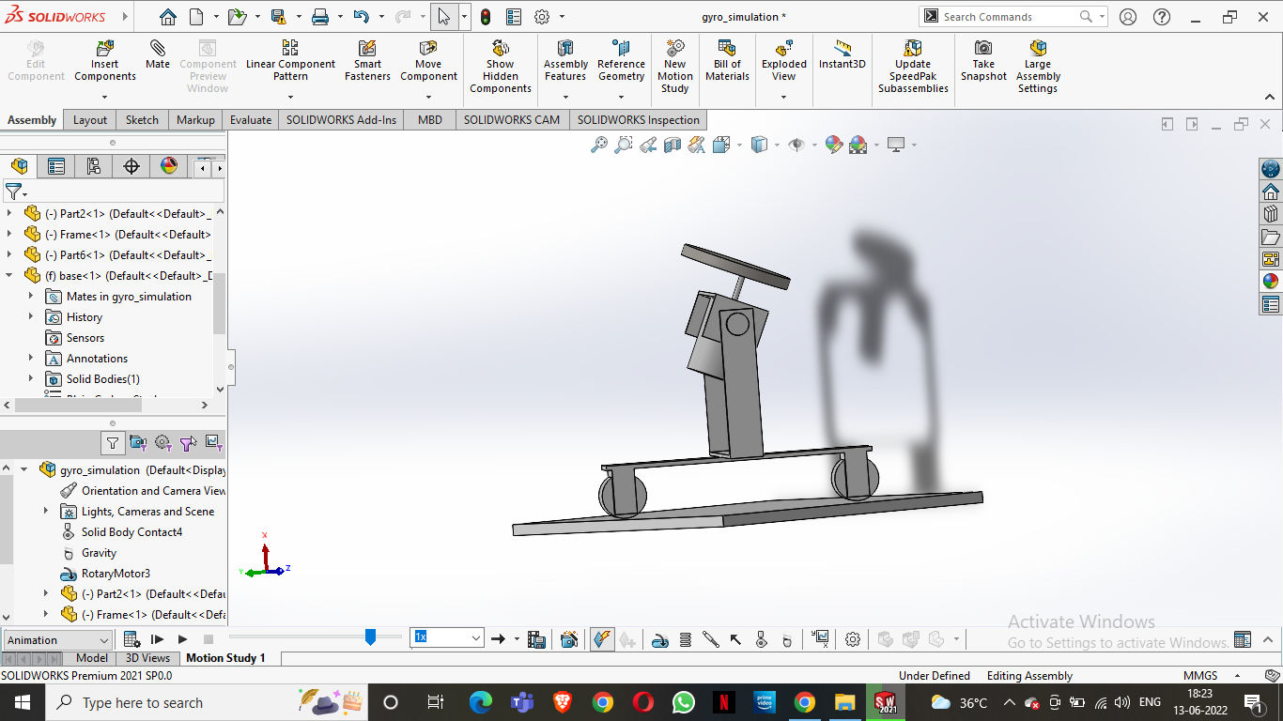
Design of CMG system
A CAD model has been assembled as shown in figure. The system was divided mainly into 3 parts, Flywheel, Gimbal with motor and a Frame with wheels. Various other CAD designs are prepared for fabrication purposes.
3D model of Test Rig

Slide 13
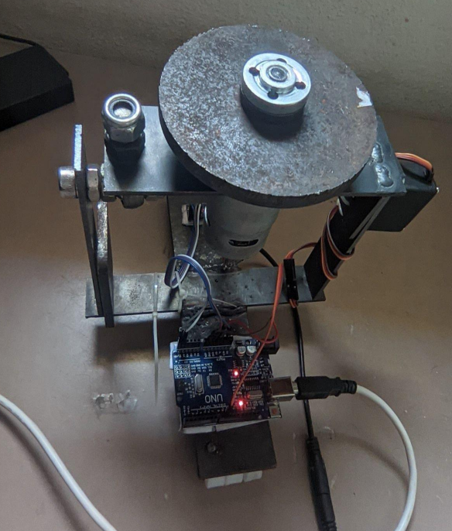
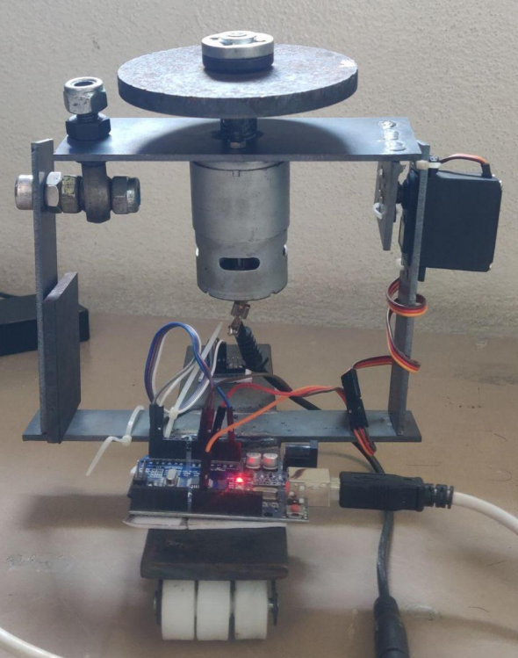
Fabrication of Test rig
Based on the result from the simulation and availability of parts the test rig is developed as shown in the figure below.
Figure 2:Isometric view of Test rig
Figure 3:Side of Test rig

Slide 14

Working model

Slide 15
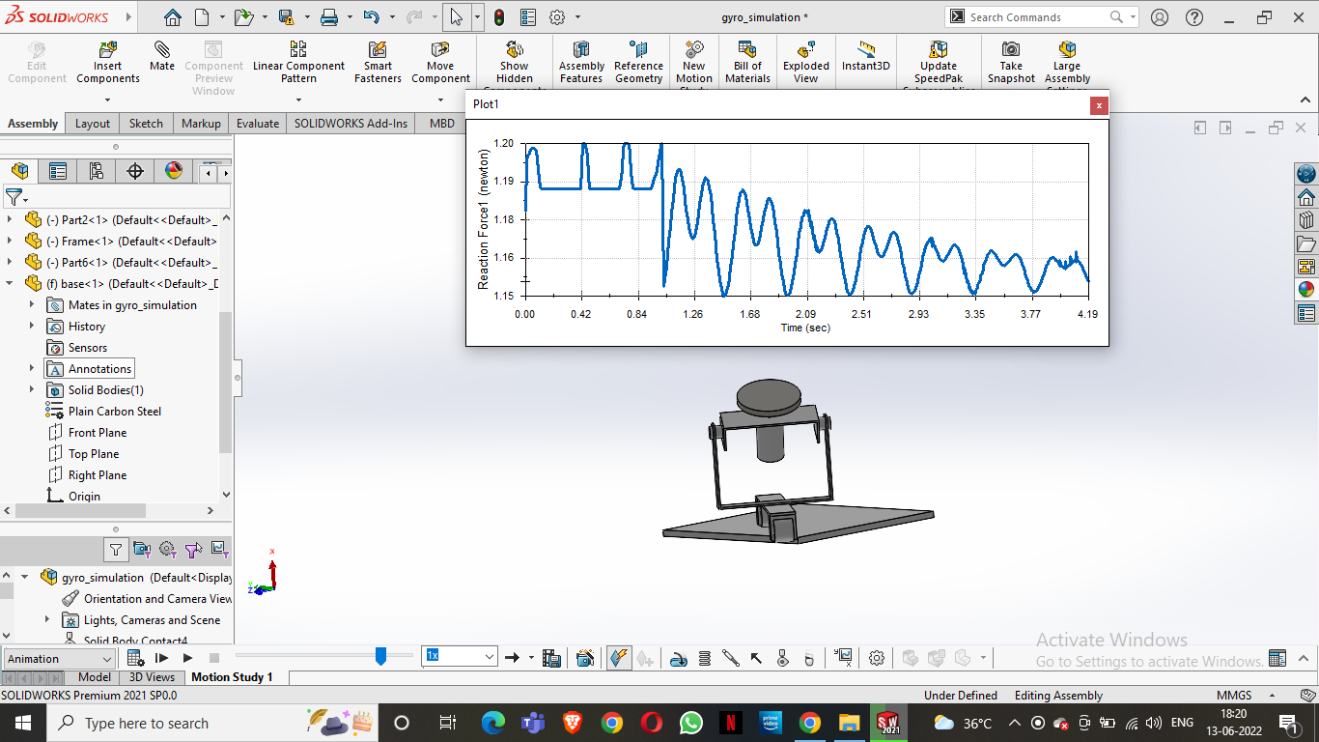
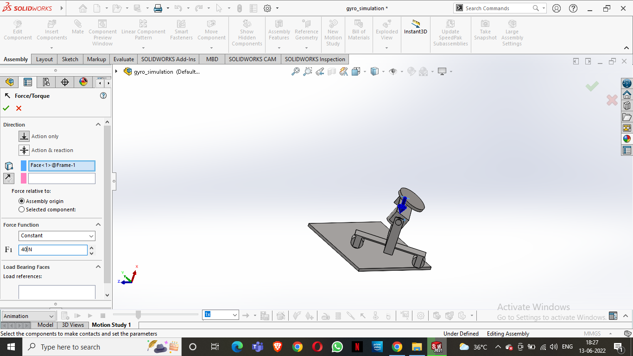
Results
A 40N force is applied as shown in figure 1 and the reaction force generated by precession is shown in figure 2. Model became stable with in 5s.
Figure 4: 3D CAD Model indicating the force applied
Figure 5: Representing the reaction force generated by flywheel when force is applied

Slide 16
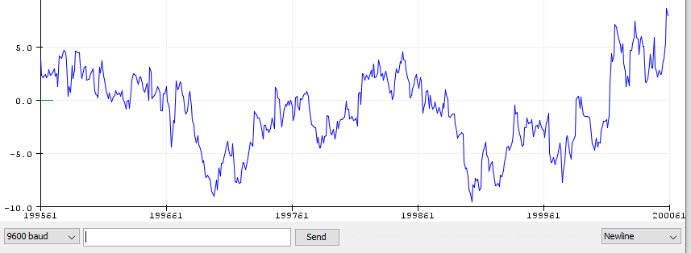
Results
From figure 6, it is observed that the feedback of angle from MPU6050 is present even when no tilt or force is applied on the test rig. This error can be avoided by setting a proper condition statement in the Arduino code.
Figure 6: Angle from MPU050 when no Input is given

Slide 17
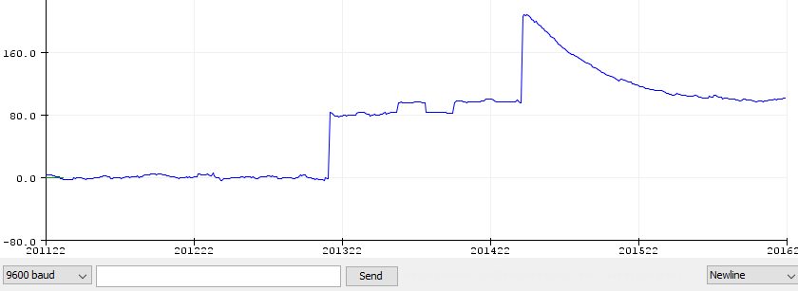
Results
To balance the vehicle using control moment gyroscope, the precession of the flywheel is controlled by the servo. With respect to change in the tilt of the vehicle the servo is actuated to certain angle until the vehicle is
balanced. The reactive angle is
shown in figure 7.
Figure 7: Servo reactive position vs time when external force is applied.

Slide 18
Conclusions
This project presents the design and fabrication of a control moment gyroscope for a two-wheeled self-balancing vehicle that can balance itself under the application of external forces and loads. The vehicle balances itself under various conditions like the forced tilt of the vehicle. The results from simulation and experimentation are found to be close and similar. Thus, the proposed system can be much helpful for two-wheeled vehicles reducing accidents or unwanted falls and increasing safety for the rider. The results obtained by doing this are satisfactory, but still, some improvements can be made to the position sensor and the delay gap between sensor and servo can be reduced. By fabricating the test the results of the simulation are validated and various other types of testing are done. It can be concluded that it is better to use a two-flywheel gyroscopic system as a safety measure. Hence designing a low-space and compact vehicle is essential to reduce traffic congestion. The areas of application of this system are, stabilizing the two wheelers such that physically disabled people can also drive the two wheelers. To implement autonomous driving in two-wheelers it is very important to balance the vehicle. Hence this type of system can be used to achieve autonomous driving in two-wheelers.

Slide 19
Future Scope
Based on the results from this project the system can be implemented along with a two-flywheel mechanism for improved safety and stability.
By using this mechanism in two-wheelers, the motorcycles can be converted into autonomous vehicles by developing a control system.
The efficiency of the control moment gyroscope system can be improved by developing a vacuum enclosure around the flywheel to reduce the air pressure thereby reducing the air resistance to the rotating disc.
This mechanism can also be used to make Two wheeler vehicles for people suffering from disabilities.

Slide 20
References
[1] | T.-D. Chu and C.-K. Chen, “Design and implementation of model predictive control for a gyroscopic inverted pendulum,” Appl. Sci., vol. 7, no. 12, p. 1272, 2017
[2] | J. Chen, P. Ye, H. Sun and Q. Jia, "Design and motion control of a spherical robot with control moment gyroscope," 2016 3rd International Conference on Systems and Informatics (ICSAI), 2016, pp. 114-120, doi: 10.1109/ICSAI.2016.7810940.
[3] | James Demello, How to Build a Self-Balancing Gyroscopic Vehicle
[4] | E. Mumm, K. Davis, M. Mahin, D. Neal, and R. Hayes, "Miniature Control Moment Gyroscope development," 2014 IEEE Aerospace Conference, 2014, pp.1-9,doi: 10.1109/AERO.2014.6836474.
[5] | Amato Parsa, Hoghooghi Chiara, Settineri Trilok, Sadarangani Lit Motors & A New Power in Personal Transport Case Study I&E 352(2014) .
[6] | M.-H. Hsieh, Y.-T. Chen, C.-H. Chi, and J.-J. Chou, “Fuzzy sliding mode control of a riderless bicycle with a gyroscopic balancer,” in 2014 IEEE International Symposium on Robotic and Sensors Environments (ROSE) Proceedings, 2014, pp. 13– 18.
[7] | Jackson Wahl, Dhanush Madabusi & Scout Stohrer Lit Motors & A New Power in Personal Transport Case Study

Slide 21


